Slide 1



TEAM PRAMAL
Presented By:
Komal Shikha
Preety Kumari
Pradyuman Kumar

Slide 2
Abstract
The purpose of our project is to minimize the problems of road accidents in night. By using this system in our vehicles dazzle problem is almost solved. The number of vehicles on our roads is burgeoning day by day. This is turn forced almost all this vehicle manufactures to think about the extra safety instruments and electronic controls to attach with these products for giving the users a safety derived in all road conditions through a mass flow traffic. If asked, one should always mention that the right driving is very cumber some due to the dazzling light problems and the frequent dipping of headlights by manual means that often causes fatigue to the driver particularly at the time of peak traffic. The auto dipper can perform a great deal in reducing the manual efforts and fatigue of drivers in dipping the headlamp frequently while driving through highways full of moving vehicles. However, vehicles employed with automatic dippers are not very often seen in our cities, and it may be due to lack of information about the system and also because of giving attention to the people saying that it is not at all practicable in our highways.

Slide 3
CONTENTS
1. What is Auto Dipper?
2. Components
3. Circuit Diagram
4. Installation
5. Salient Features
6. Applications
7. Conclusion
8. Future Scope

Slide 4
Auto Dipper is highly sophisticated electronic device that switches head lights of an automobile/vehicle to differ mode(low beam) automatically when the sharp light beam lights off an on coming vehicle falls on its windscreen . And it switches back from dipper mode (low beam) to main beam (high beam) automatically once the on coming vehicle passes off . This happens within a fraction of seconds .

Slide 5

Relay
Printed circuit board(PCB)
Optical sensor(LDR)
Resistors
Diodes
Capacitors
NE555N Timer IC
Lamp
Switch

Slide 6

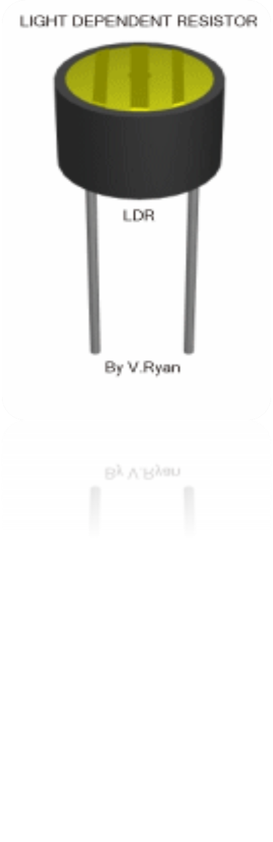
LDRs or Light Dependent Resistors are very useful especially in light/dark sensor circuits. Normally the resistance of an LDR is very high, sometimes as high as 1000 000 ohms, but when they are illuminated with light resistance drops dramatically.

Slide 7
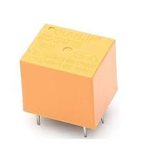

A relay is an electrical switch that opens and closes under the control of another electrical circuit. In the original form, the switch is operated by an electromagnet to open or close one or many sets of contacts. It was invented by Joseph Henry in 1835. Because a relay is able to control an output circuit of higher power than the input circuit, it can be considered, in a broad sense, to be a form of an electrical amplifier.

Slide 8
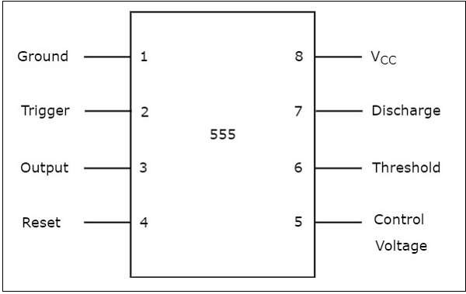

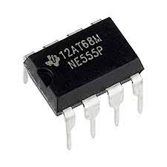
The basic 555 timer gets its name from the fact that there are three internally connected 5kΩ resistors which it uses to generate the two comparators reference voltages. The 555 timer IC is a very cheap, popular and useful precision timing device which can act as either a simple timer to generate single pulses or long time delays, or as a relaxation oscillator producing a string of stabilised waveforms of varying duty cycles from 50 to 100%.

Slide 9

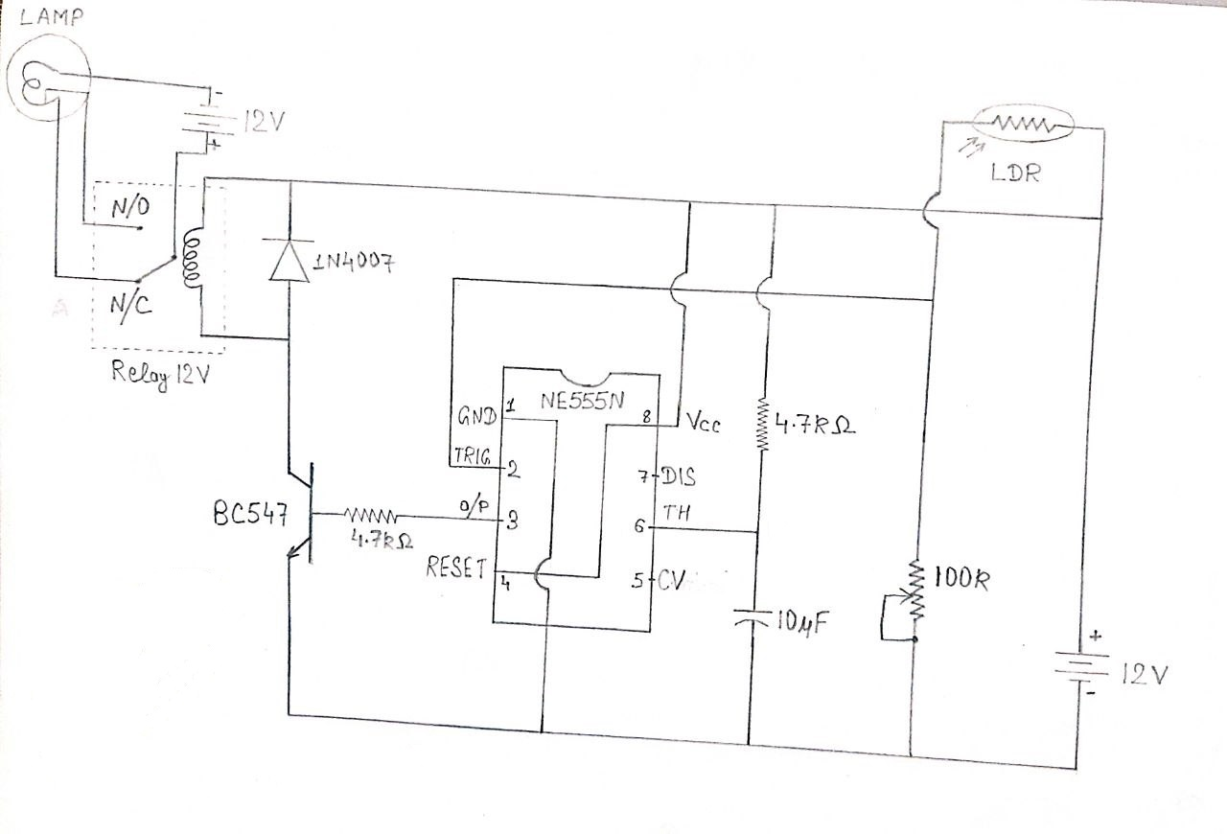

Slide 10

AUTODIP is a very compact small size device and can easily be mounted and fitted easily anywhere inside in any automobile / vehicle or under the bonnet and sensor is concealed and mounted on the indicator by an auto electrician or by company-trained personnel. The entire process has only two steps physical installation and electrical integration. The whole process takes only 5 to 10 minutes.

Slide 11
Salient Features:
Main function is automatic control of headlamps beam
This Intelligent device (AUTODIP) automatically understands the well Lit and Dark roads and functions accordingly and promptly
Understands the type of roads including curves and straight
Understands approaching traffic’s DIP and MAIN beams
Device also understands the dipper switch position
The head lamp ON/OFF status It is designed to withstand: Vibrating environment, Bumpy roads, sudden temperature variations, Salty and chemical environment, etc.

Slide 12

It keeps the head lamps in main beams if there is no vehicle from the opposite direction.
It dips the head lamps automatically on encountering another vehicle from the opposite direction and restores main beam at crossing points if the opposite driver also dips his head lamps.
It restores the main beam much before crossing if the oppostite driver does not dip his head lamps within the safe stopping sight distance of 100 meters.
It dips the head lamps of both the vehicles if fitted to both vehicles.
It maintains headlamps in main beams on encountering dense traffic from opposite direction on a dark road.

Slide 13
CONCLUSION
Newer and better technologies always come with time and it will help in reducing the manual labor and difficulties in the sectors where it is made use. And in our case, the auto dipper can perform a great deal in reducing the manual efforts and fatigue of drivers in dipping the headlamp frequently while driving through highways full of moving vehicles. However, vehicles employed with automatic dippers are not very often seen in our cities and it may be due to lack of information about the system and also because of giving attention to the people saying that it is not at all practicable in our highways. Yes, of course it has got some drawbacks like that one which is most common, when we drive the vehicle fitted with automatic dippers on a road in which different types of vehicles and hence varying light intensities cause frequent flickering of the headlight. And also the operation of the system eliminated or reduced by devising newer methods and technologies. The one nowadays available is only useful in highways and straight width roads. Truly speaking, auto dippers are devices, which will attain more and more importance in the forthcoming years. In short, it is a device with a very bright future. The number of vehicles and the condition of the roads are improving very fast and the day is near, when the driving regulation, nature of traffic etc., are growing up to the levels which is already there in countries like America who successfully using auto dippers in their highways.

Slide 14

It can also improved by deciding it is not to affect by street lights and other light, it is not very successful in India but in future all the car manufacturer company may think about it for install in all the vehicles our central government with Punjab government tries to use this in 2004 and it was not too successful. The cost of this system is across 5000–7000 per vehicles and its life is almost 10 years and it can reduces the problem of road accidents at night due to dazzling of light and problem of glare. An auto dipper could play a crucial role in shifting the headlights from driving beam to meeting beam and vice versa. This will improve visibility by minimizing glare, a major cause of momentary loss of vision. The realization of the ultimate goal of total road safety through creating ideal visibility conditions is dependent on efforts in all other related areas mentioned above.

Slide 15

THANK
YOU

